Slide 1
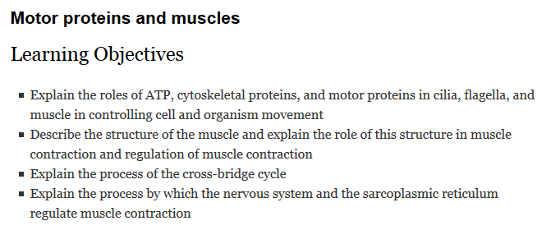
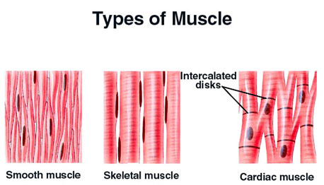
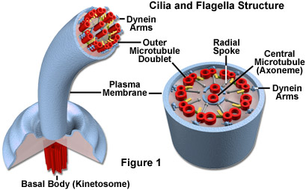
Effectors & Movement I

Slide 2
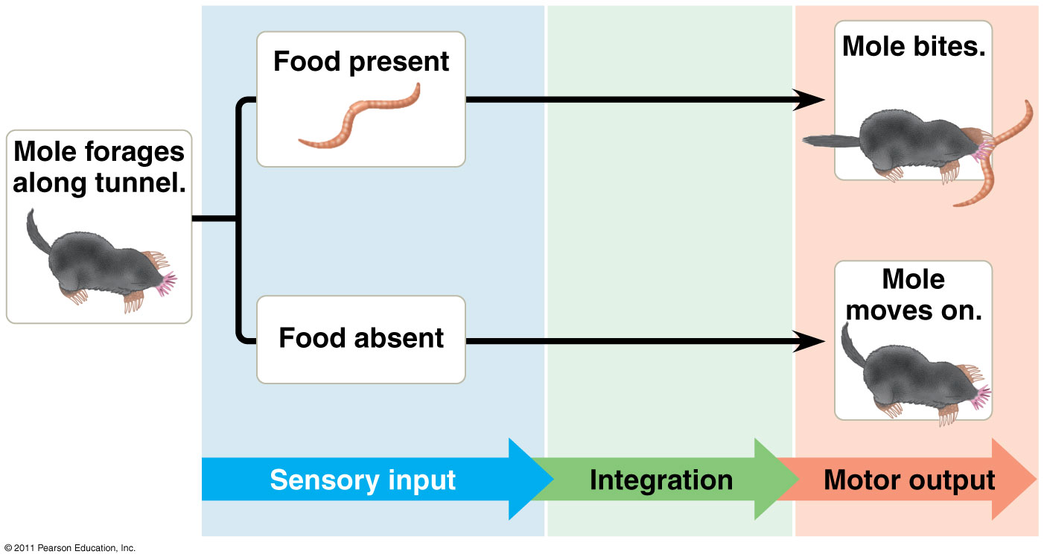
Sensory Input ->Motor Response

Slide 3
Key Concepts
Cilia and flagella move individual cells
Muscles move organisms or parts of organisms
Cilia, flagella, and muscles rely on motor proteins and ATP
Most muscle movement is dependent upon signals from efferent neurons
Different skeletal systems facilitate movement in different ways

Slide 4
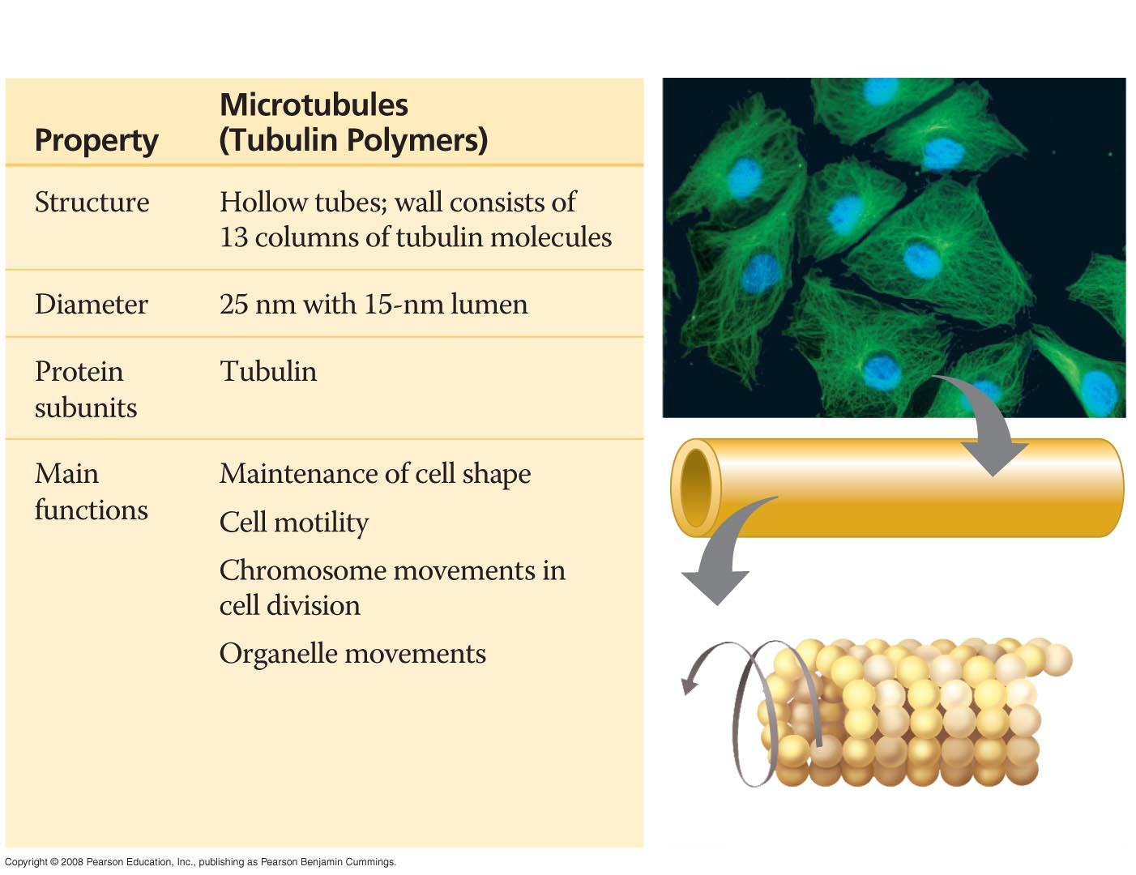
Table 6-1a
10 µm
Column of tubulin dimers
Resist compression
Creates tracks for intracellular movement
25 nm
α
β
Tubulin dimer

Slide 5
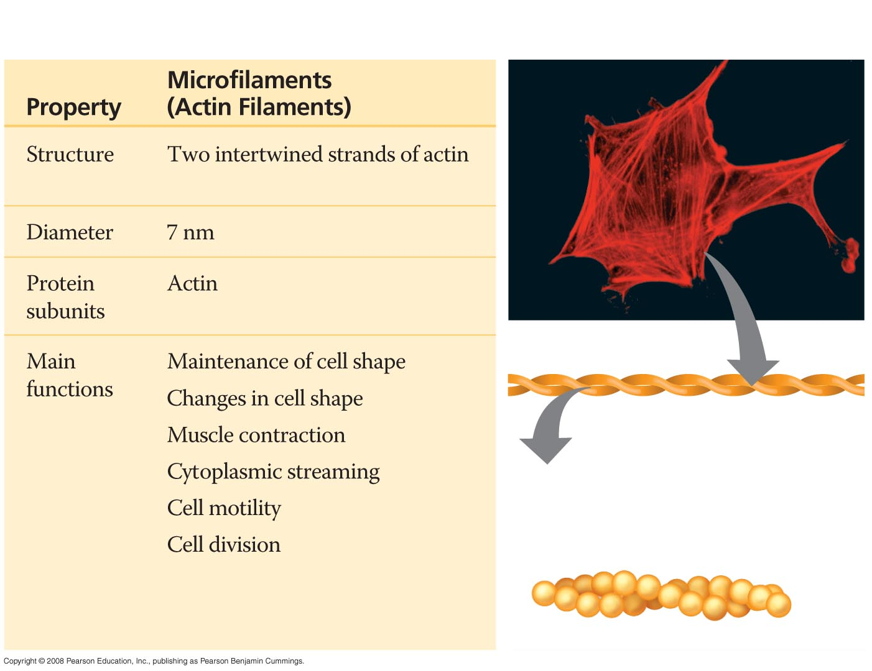
Table 6-1b
10 µm
Actin subunit
Resist tension
7 nm

Slide 6
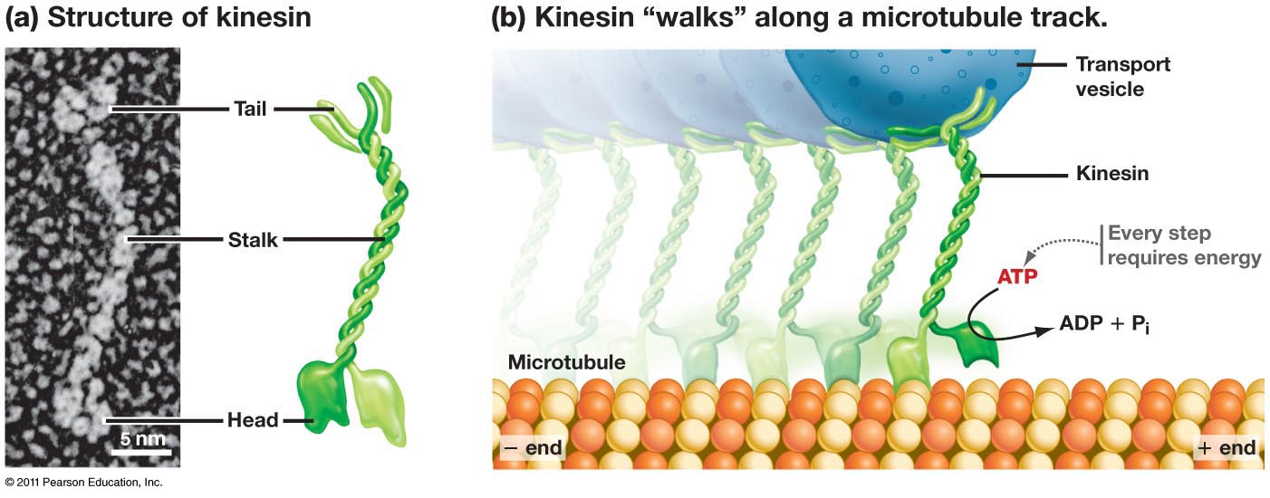
Motor proteins
Motor proteins convert ATP into movement – walk along a specific cytoskeletal element
Cilia/flagella = dynein walks along microtubule track
Muscle = myosin walks along actin filament

Slide 7
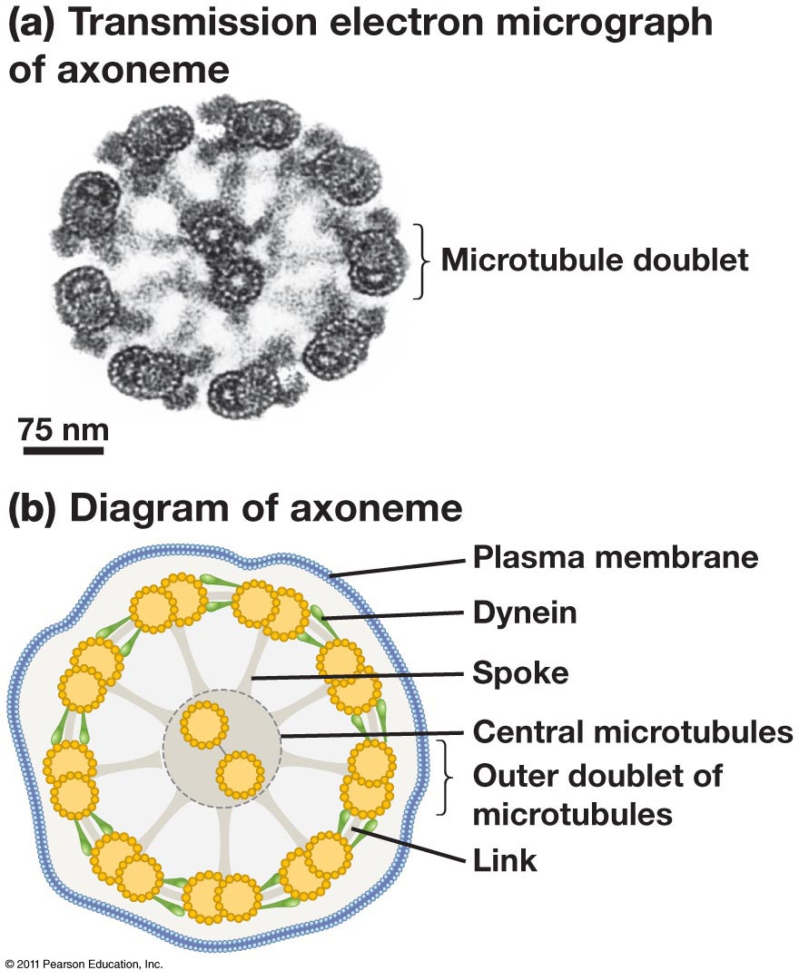
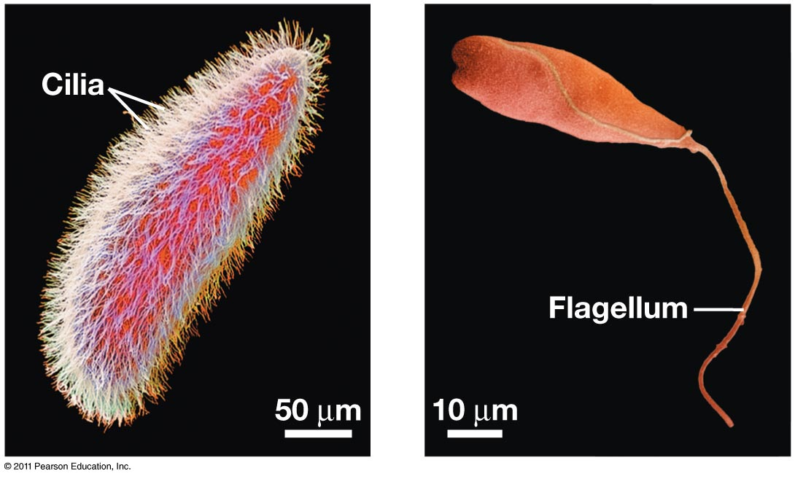
Eukaryotic cilia and flagella have common evolutionary origin
Eukaryotic flagella =/= prokaryotic flagella
Eukaryotic flagella = cilia
Constructed of microtubules (prokaryotic flagella constructed of flagellin)
Motor protein in cilia/flagella = dynein

Slide 8
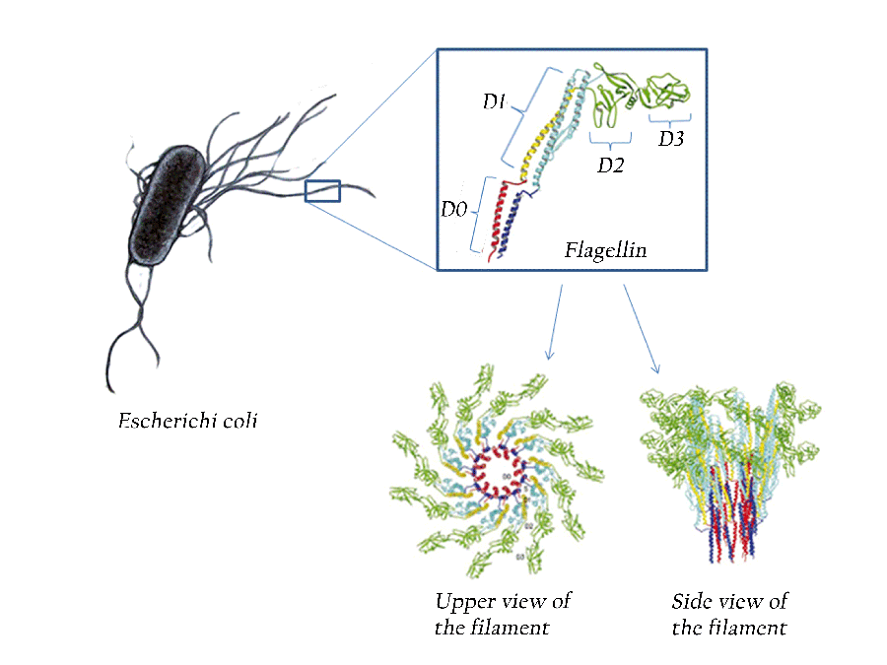
Eukaryotic cilia and flagella have common evolutionary origin
Eukaryotic flagella =/= prokaryotic flagella
Eukaryotic flagella = cilia
Constructed of microtubules (prokaryotic flagella constructed of flagellin)
Motor protein in cilia/flagella = dynein

Slide 9
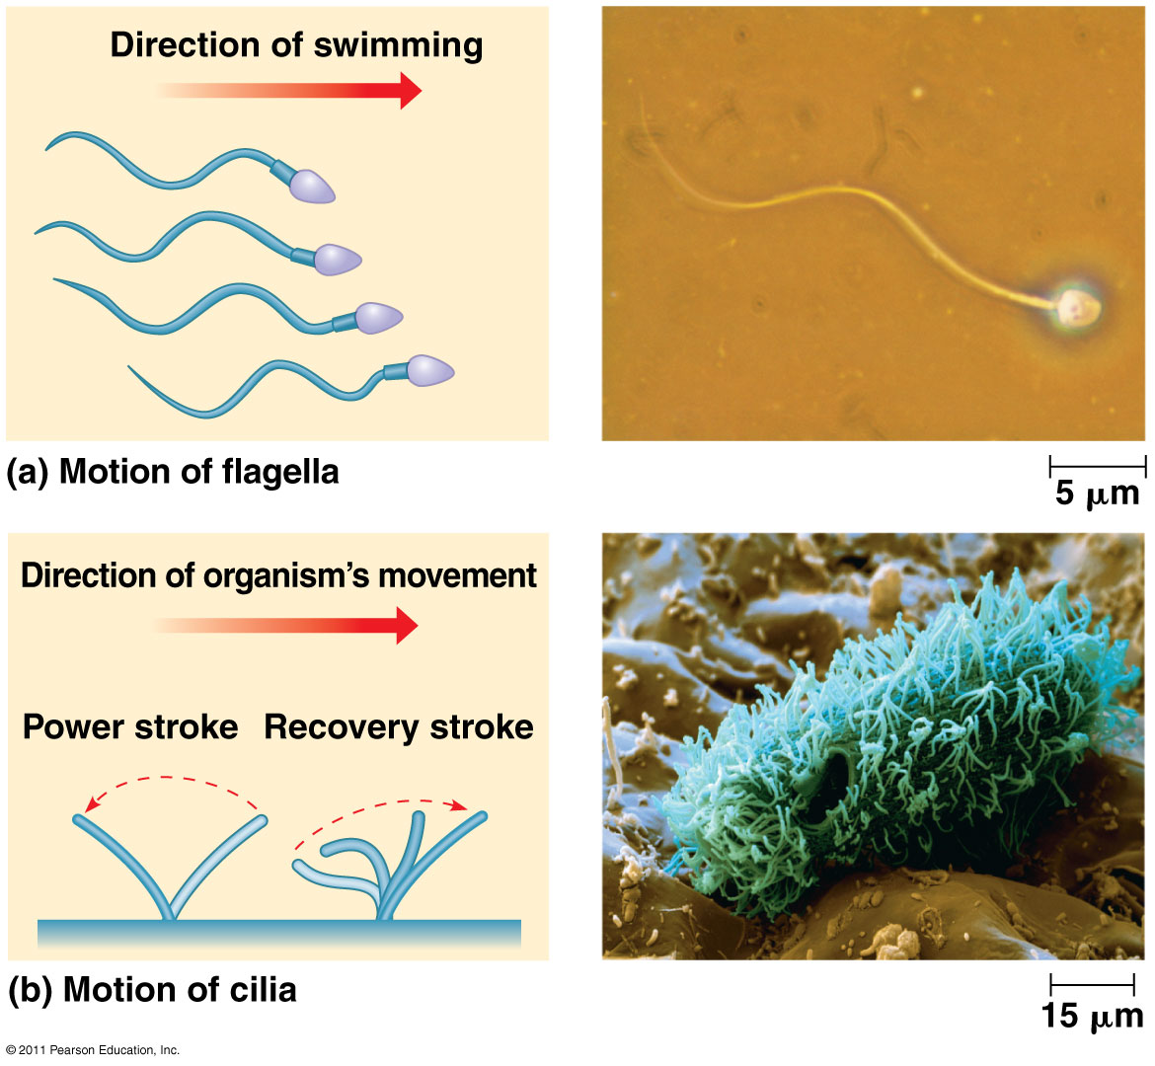
Movement of cilia and flagella

Slide 10
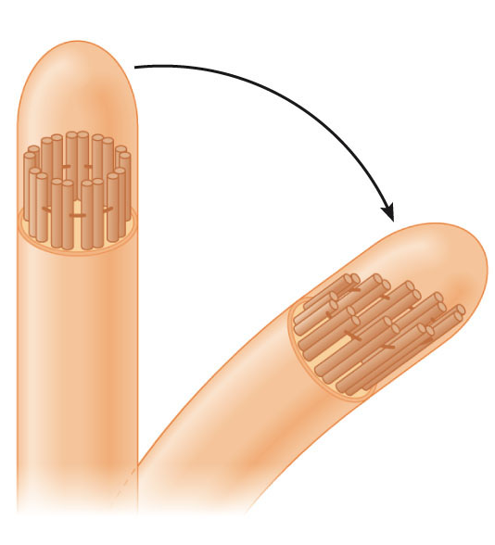
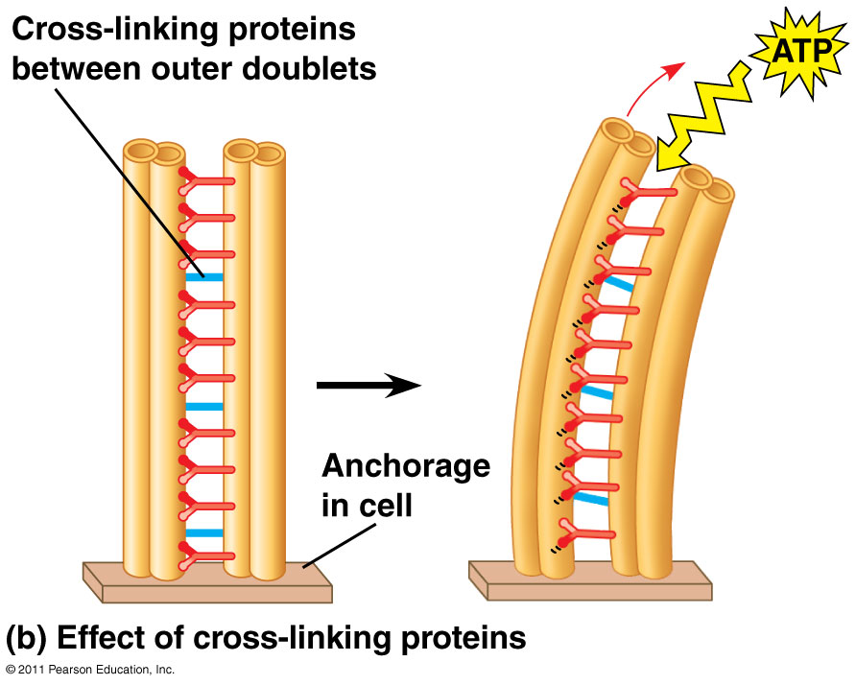
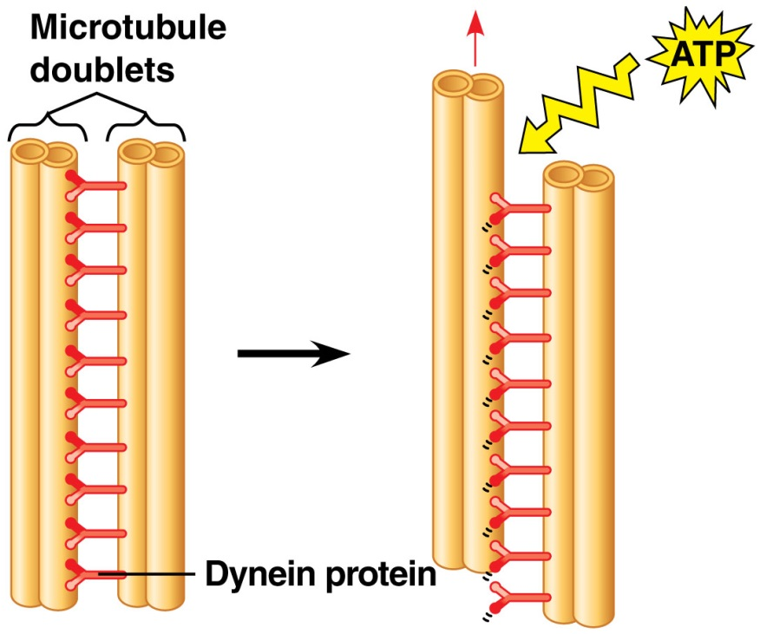
Dynein ‘walking’
http://www.yellowtang.org/animations/flagella.swf
Left: what would happen if microtubule doublets were free; Right: the doubles are fixed to the base of the axoneme and crosslinked to the adjacent doublet in cilia and flagella

Slide 11
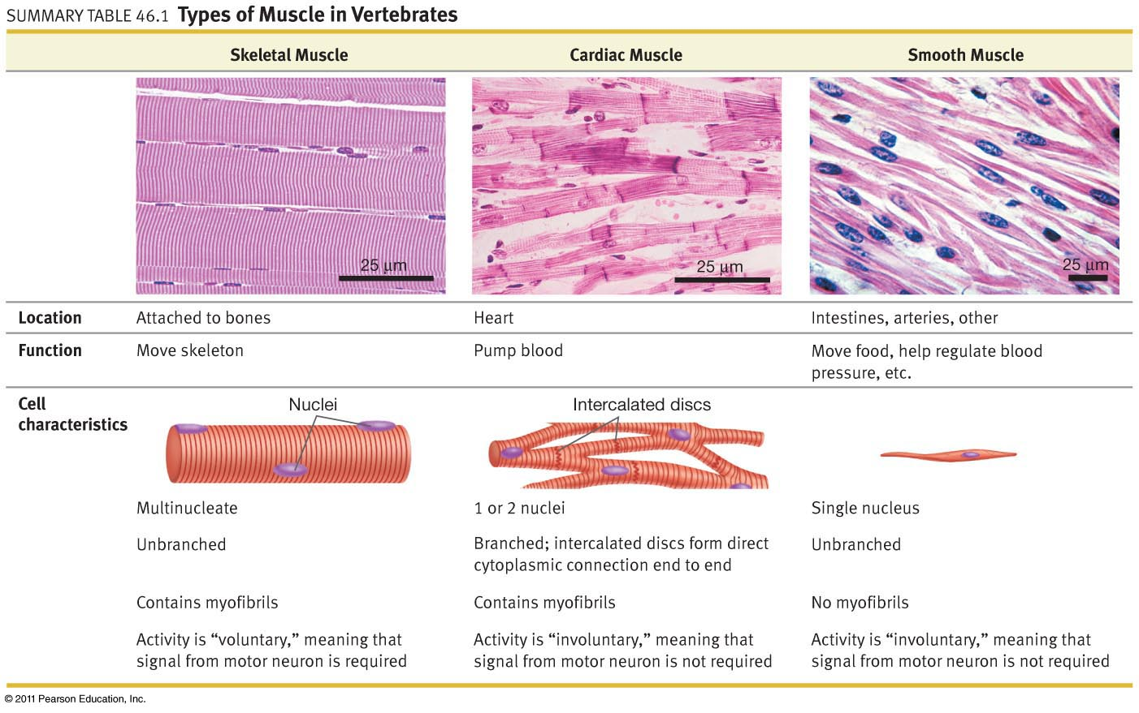
Vertebrate muscle types

Slide 12
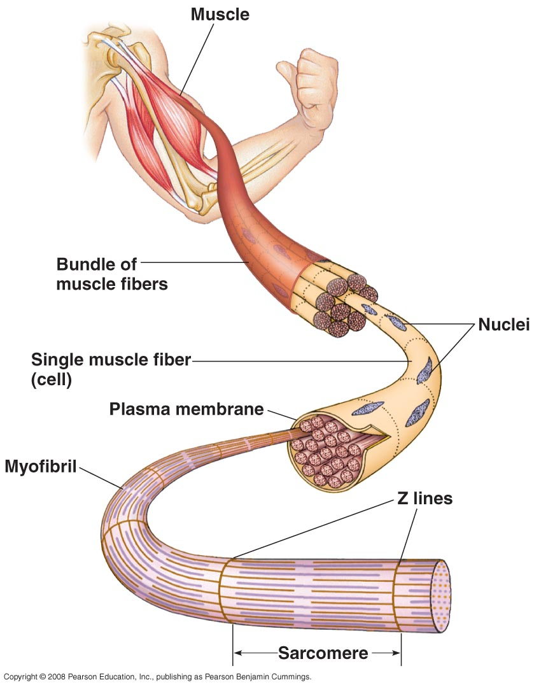
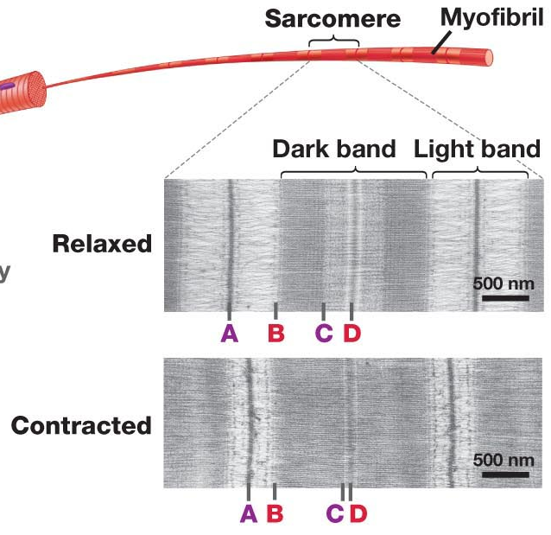
Vertebrate skeletal muscle
One muscle fiber = one muscle cell (multinucleate)
Myofibril = structure within muscle cell with repeating sarcomeres
Sarcomere = contractile unit; alternating light/dark units
A-C = one length of actin filament
B-D = one length of myosin

Slide 13
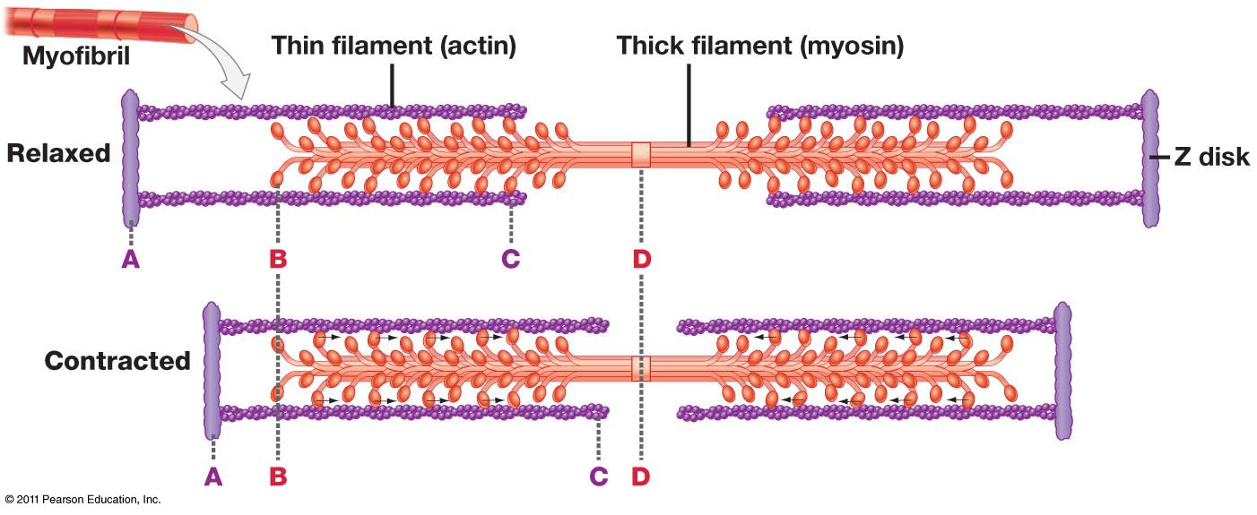
The sliding filament model
Myofibrils are composed of two kinds of myofilaments:
Thin filaments (type of microfilament or actin filament) consist of two strands of actin and two regulatory proteins
Thick filaments are staggered arrays of myosin molecules
Skeletal muscle is striated because the regular arrangement of myofilaments creates a pattern of light and dark bands
Filaments slide past each other, causing more overlap between thin and thick filaments
There is no change in filament length; the muscle contracts as the filaments slide past each other

Slide 14
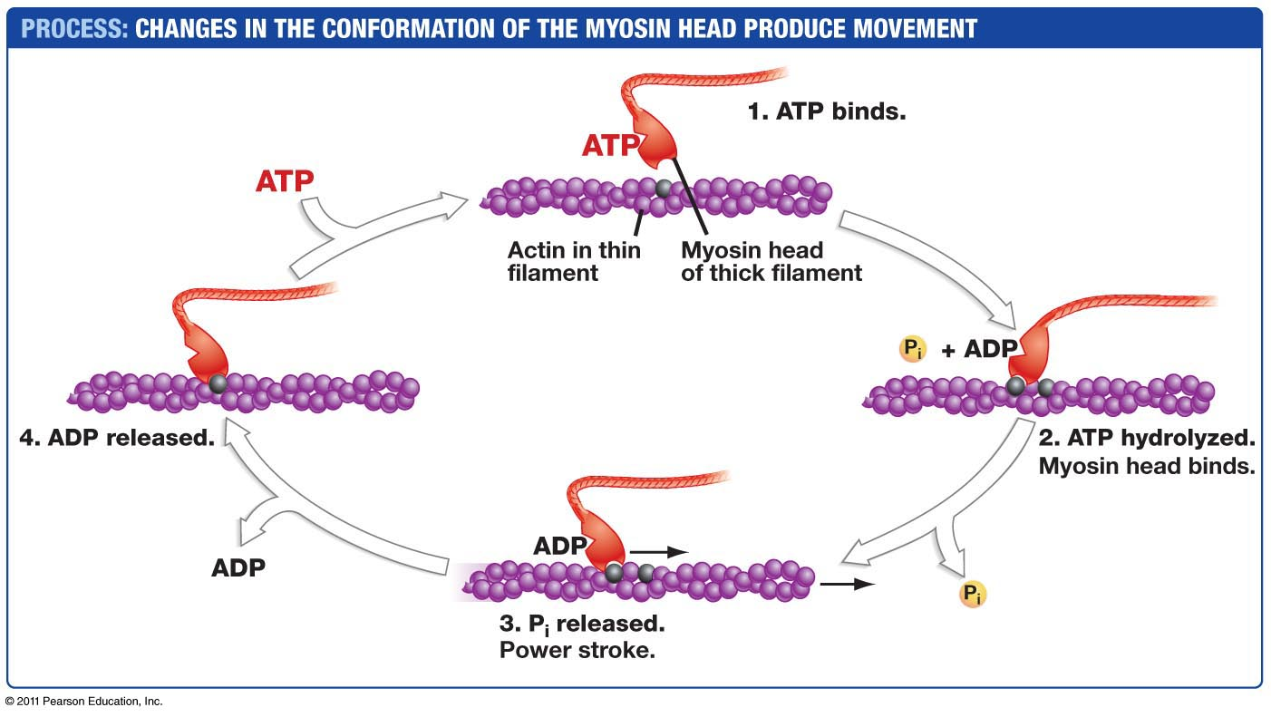
ATP regulates myosin activity

Slide 15
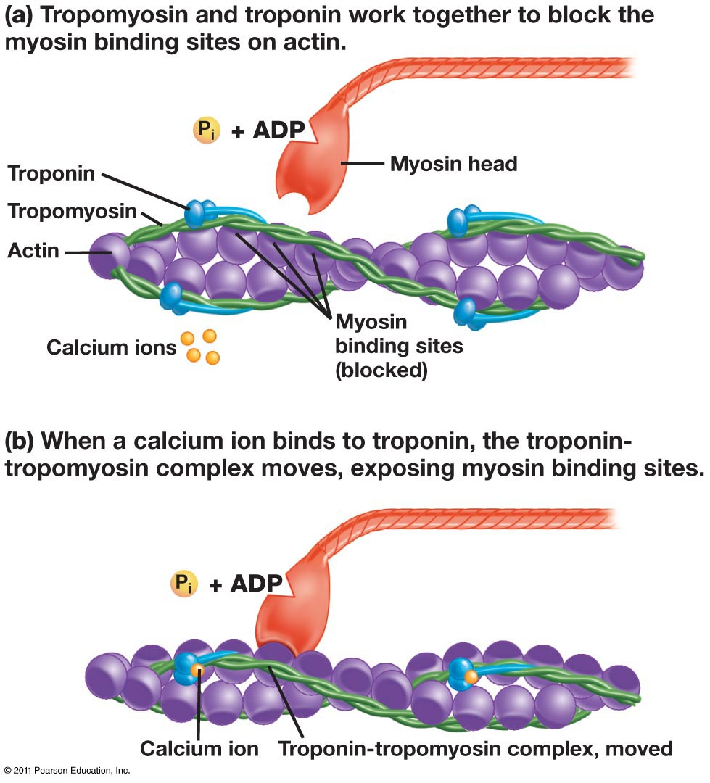
When a muscle is at rest, myosin-binding sites on the thin filament are blocked by the regulatory protein tropomyosin
For a muscle fiber to contract, myosin-binding sites must be uncovered so myosin can bind and walk along the actin filament
Ca²⁺ binds to the regulatory protein, troponin; this binding causes a conformational shift which moves the troponin-tropomyosin complex to expose the myosin-binding sites on actin

Slide 16
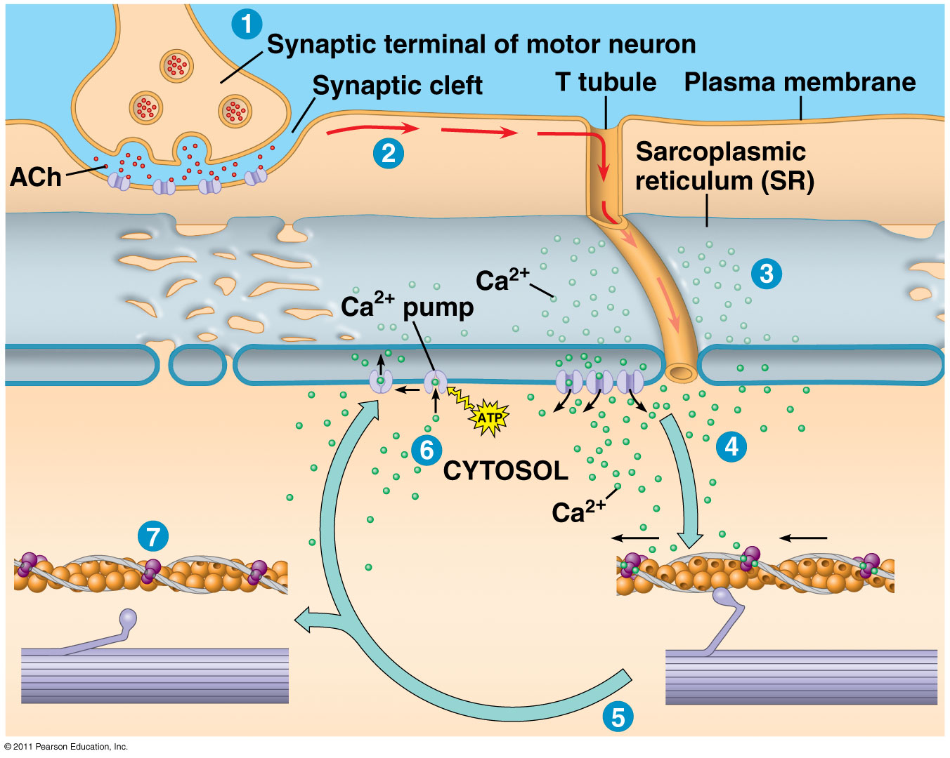
Skeletal muscle contraction is regulated by the neurotransmitter acetlylcholine (ACh)

Slide 17
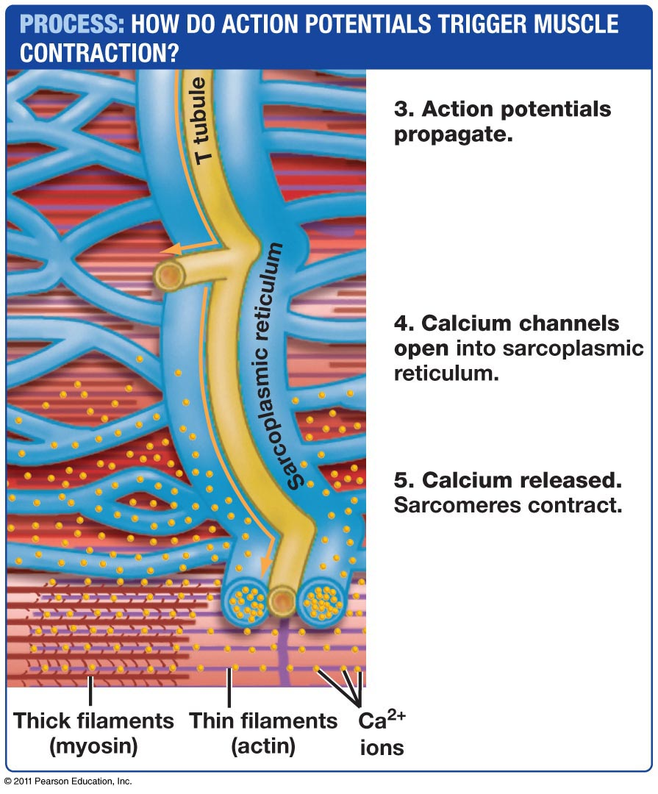
T tubules are invaginations of the muscle plasma membrane wich transmit the action potential to the interior of the muscle fiber (cell)
The sarcoplasmic reticulum consists of specialized sheets of smooth ER which contain high concentrations of calcium ions
Free calcium binds troponin, causing tropomyosin to move and exposing the myosin-binding sites on the actin filament

